Slide 1
Event Handling

Slide 2
What is an Event?
GUI components communicate with the rest of the applications through events.
The source of an event is the component that causes that event to occur.
The listener of an event is an object that receives the event and processes it appropriately.

Slide 3
Handling Events
Every time the user types a character or clicks the mouse, an event occurs.
Any object can be notified of any particular event.
To be notified for an event,
  The object has to be registered as an event listener on the appropriate event source.
  The object has to implement the appropriate interface.

Slide 4
An example of Event Handling
public class SwingApplication implements ActionListener {
...
JButton button = new JButton("I'm a Swing button!");
button.addActionListener(this);
....
public void actionPerformed(ActionEvent e) { numClicks++;
label.setText(labelPrefix + numClicks);
}
}

Slide 5
The Event Handling process
When an event is triggered, the JAVA runtime first determines its source and type.
If a listener for this type of event is registered with the source, an event object is created.
For each listener to this type of an event, the JAVA runtime invokes the appropriate event handling method to the listener and passes the event object as the parameter.

Slide 6
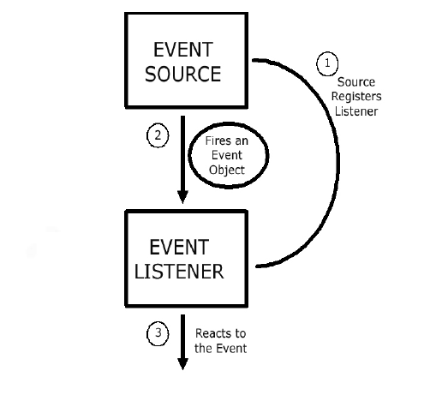
The Event Handling Process
(contd..)

Slide 7
What does an Event Handler require?
It just looks for 3 pieces of code!
First, in the declaration of the event handler class, one line of code must specify that the class implements either a listener interface or extends a class that implements a listener interface.
public class DemoClass implements ActionListener {

Slide 8
What does an Event Handler require? (contd..)
Second, it looks for a line of code which registers an instance of the event handler class as a listener of one or more components because, as mentioned earlier, the object must be registered as an event listener.
anyComponent.addActionListener(instanceOf DemoClass);

Slide 9
What does an Event Handler require? (contd..)
Third, the event handler must have a piece of code that implements the methods in the listener interface.
public void actionPerformed(ActionEvent e) {
...//code that reacts to the action...
}

Slide 10
Types of Events
Below, are some of the many kinds of events, swing components generate.
Act causing Event | Listener Type
User clicks a button, presses Enter, typing in text field | ActionListener
User closes a frame | WindowListener
Clicking a mouse button, while the cursor is over a component | MouseListener

Slide 11
Types of Events (contd..)
Act causing Event | Listener Type
User moving the mouse over a component | MouseMotionListener
Component becomes visible | ComponentListener
Table or list selection changes | ListSelectionListener

Slide 12
The Event classes
An event object has an event class as its reference data type.
The Event object class
  Defined in the java.util package.
The AWT Event class
  An immediate subclass of EventObject.
  Defined in java.awt package.
  Root of all AWT based events.

Slide 13
Event Listeners
Event listeners are the classes that implement the
<type>Listener interfaces.
Example:
1. ActionListener receives action events
2. MouseListener receives mouse events.
The following slides give you a brief overview on some of the listener types.

Slide 14
The ActionListener Method
It contains exactly one method.
Example:
public void actionPerformed(ActionEvent e)
The above code contains the handler for the ActionEvent e that occurred.

Slide 15
The MouseListener Methods
Event handling when the mouse is clicked.
public void mouseClicked(MouseEvent e)
Event handling when the mouse enters a component.
public void mouseEntered(MouseEvent e)
Event handling when the mouse exits a component.
public void mouseExited(MouseEvent e)

Slide 16
The MouseListener Methods (contd..)
Event handling when the mouse button is pressed on a component.
public void mousePressed(MouseEvent e)
Event handling when the mouse button is released on a component.
public void mouseReleased(MouseEvent e)

Slide 17
The MouseMotionListener Methods
Invoked when the mouse button is pressed over a component and dragged. Called several times as the mouse is dragged
public void mouseDragged(MouseEvent e)
Invoked when the mouse cursor has been moved onto a component but no buttons have been pushed.
public void mouseMoved(MouseEvent e)

Slide 18
The WindowListener Methods
Invoked when the window object is opened.
public void windowOpened(WindowEvent e)
Invoked when the user attempts to close the window object from the object’s system menu.
public void windowClosing(WindowEvent e)

Slide 19
The WindowListener Methods (contd..)
Invoked when the window object is closed as a result of calling dispose (release of resources used by the source).
public void windowClosed(WindowEvent e)
Invoked when the window is set to be the active window.
public void windowActivated(WindowEvent e)

Slide 20
The WindowListener Methods (contd..)
Invoked when the window object is no longer the active window
public void windowDeactivated(WindowEvent e)
Invoked when the window is minimized.
public void windowIconified(WindowEvent e)
Invoked when the window is changed from the minimized state to the normal state.
public void windowDeconified(WindowEvent e)

Slide 21
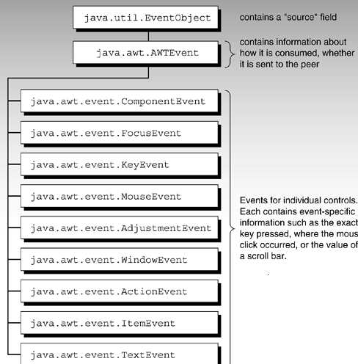
Hierarchy of event objects
Note: The number of event objects is much greater then specified in diagram…Due to space constraints, only some of them are represented in the figure
Courtesy: Safari.oreilly.com

Slide 22
Additional Listener Types
Item Listener
Key Listener
Property Change Listener
Table Model Listener
Change Listener
Container Listener
Document Listener
Focus Listener
Internal Frame Listener
The main purpose of the last few slides is to give you an idea as to how you can use event handlers in your programs. It is beyond the scope of the O’Reilly book to cover every event handler. See the JAVA tutorials for more information.

Slide 23
Adapter classes for Event Handling.
Why do you need adapter classes?
  Implementing all the methods of an interface involves a lot of work.
  If you are interested in only using some methods of the interface.
Adapter classes
  Built-in in JAVA
  Implement all the methods of each listener interface with more than one method.
  Implementation of all empty methods

Slide 24
Adapter classes - an Illustration.
Consider, you create a class that implements a MouseListener interface, where you require only a couple of methods to be implemented. If your class directly implements the MouseListener, you must implement all five methods of this interface.
Methods for those events you don't care about can have empty bodies

Slide 25
Illustration (contd..)
public class MyClass implements MouseListener {
... someObject.addMouseListener(this);
/* Empty method definition. */
public void mousePressed(MouseEvent e) { }
/* Empty method definition. */
public void mouseReleased(MouseEvent e) { }
/* Empty method definition. */
public void mouseEntered(MouseEvent e) { }
/* Empty method definition. */
public void mouseExited(MouseEvent e) { }
public void mouseClicked(MouseEvent e) {
//Event listener implementation goes here...
}
}

Slide 26
Illustration (contd..)
What is the result?
  The resulting collection of empty bodies can make the code harder to read and maintain.
To help you avoid implementing empty bodies, the API generally includes an adapter class for each listener interface with more than one method. For example, the MouseAdapter class implements the MouseListener interface.

Slide 27
How to use an Adapter class?
/* Using an adapter class
*/
public class MyClass extends MouseAdapter {
....
someObject.addMouseListener(this);
....
public void mouseClicked(MouseEvent e) {
...//Event listener implementation goes
// here
}
}

Slide 28
Using Inner classes for Event Handling
Consider that you want to use an adapter class but you don’t want your public class to inherit from the adapter class.
For example, you write an applet with some code to handle mouse events. As you know, JAVA does not permit multiple inheritance and hence your class cannot extend both the Applet and MouseAdapter classes.

Slide 29
Using Inner classes (contd..)
Use a class inside your Applet subclass that extends the MouseAdapter class.
public class MyClass extends Applet { ...
someObject.addMouseListener(new MyAdapter());
...
class MyAdapter extends MouseAdapter { public void mouseClicked(MouseEvent e) {
//Event listener implementation here... }
}
}

Slide 30
Creating GUI applications with Event Handling.
Guidelines:
  Create a GUI class
    Describes the appearance of your GUI application.
  Create a class implementing the appropriate listener interface
    May refer to the same class as step 1.

Slide 31
Creating GUI applications with Event Handling (contd..)
  In the implementing class
    Override all methods of the appropriate listener interface.
    Describe in each method how you want to handle the events.
    May give empty implementations for the methods you don’t need.

Slide 32
Creating GUI applications with Event Handling (contd..)
  Register the listener object with the source
    The object is an instantiation of the listener class specified in step 2.
    Use the add<Type>Listener method.

Slide 33
Design Considerations
The most important rule to keep in mind about event listeners is that they must execute quickly. Because, all drawing and event-listening methods are executed in the same thread, a slow event listener might make the program seem unresponsive. So, consider the performance issues also when you create event handlers in your programs.

Slide 34
Design Considerations
You can have choices on how the event listener has to be implemented. Because, one particular solution might not fit in all situations.
For example, you might choose to implement separate classes for different types of listeners. This might be a relatively easy architecture to maintain, but many classes can also result in reduced performance .

Slide 35
Common Event-Handling Issues
You are trying to handle certain events from a component, but it doesn’t generate the events it should.
  Make sure you have registered the right kind of listener to detect the events.
  Make sure you have registered the listener on the right object.
  Make sure you have implemented the event handler correctly, especially, the method signatures.

Slide 36
References
Jia, Xiaoping, Object Oriented Software Development Using Java. Addison Wesley, 2003
http://java.sun.com/docs/books/tutorial/uiswing/events/index.html
http://java.sun.com/docs/books/tutorial/uiswing/learn/example2.html#handlingEvents
http://safari.oreilly.com/0672315467/ch09

